Slide 1
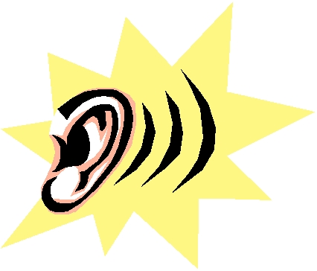
LISTEN
Lead. Lead by example
Inspire. Inspire to achieve the best outcome
See. See the unique characteristics of each person
Trust. Enable others to feel safe and confident
Encourage. Provide positive words of hope
Nurture. Cultivate humanity and foster personal growth
Notes:
Acrostic of the most important quality/skill people want
How often are you really listening or forming how you’ll respond?
Listening is not passive, it is an active skill that requires practice—
William Osler famously was best-known for saying "Listen to your patient, he is telling you the diagnosis
Reason Having pets is therapeutic—they listen; and without judgement.
Listen contains the same letters as SILENT

